Slide 1

YTP Arduino – Lesson 4
Aug 2018

Slide 2
Goals
To know your way around the Arduino IDE
To understand the purpose of functions
To understand basic code constructs
Success Criteria
Understand how to use the Arduino IDE
Complete basic coding exercises

Slide 3
Arduino IDE Checks
Open Arduino
Plugin your Arduino
Check your board
Check your port

Slide 4
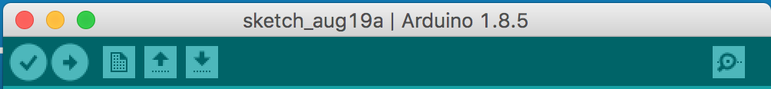
The Toolbar
Verify Code
Upload Code
Serial Monitor

Slide 5
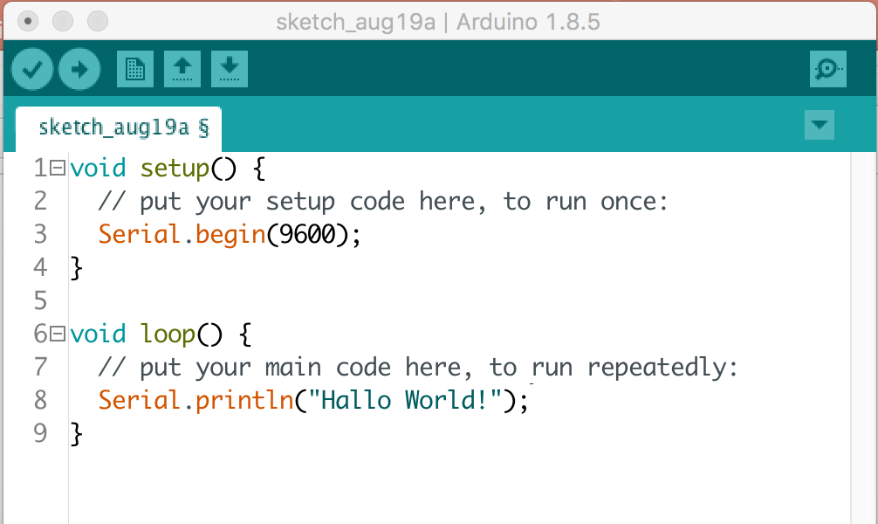
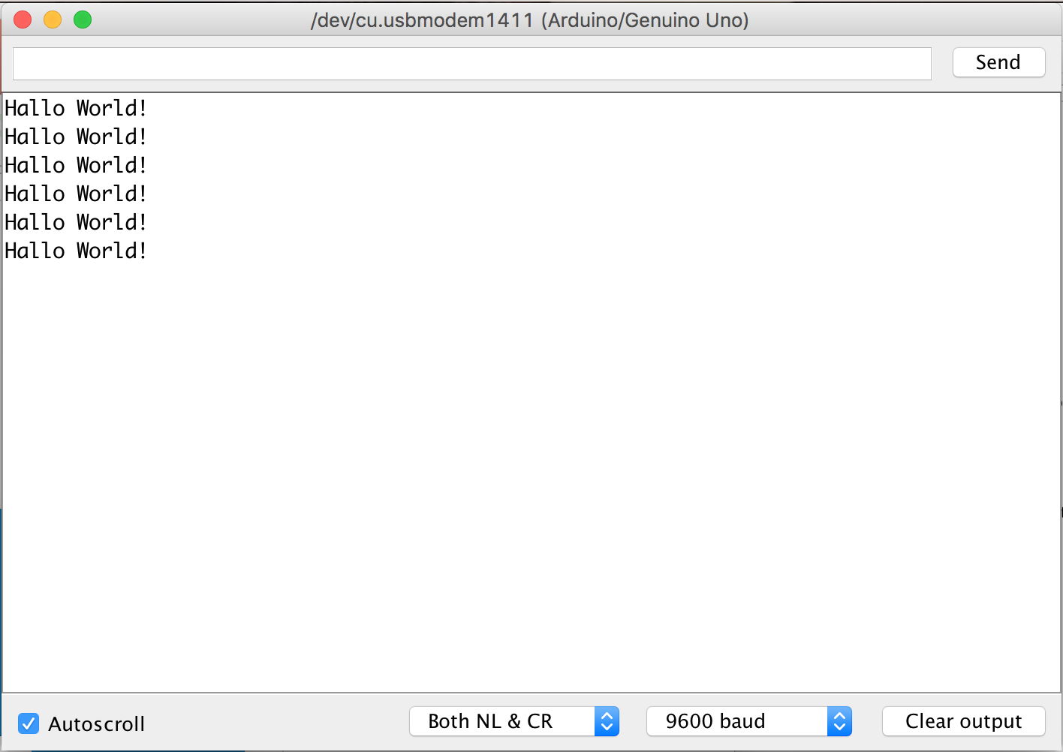
The Serial Monitor

Slide 6
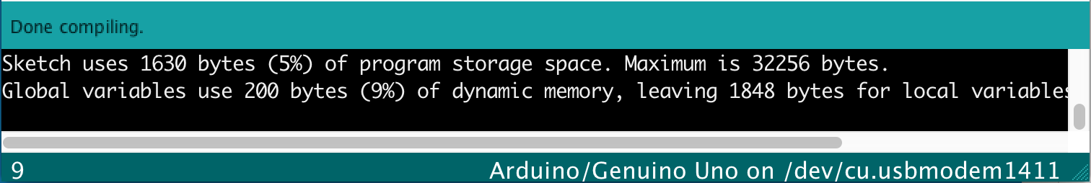
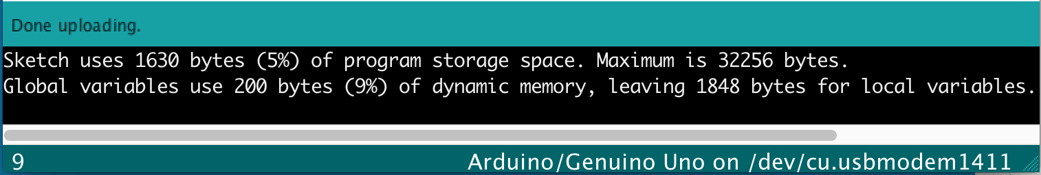
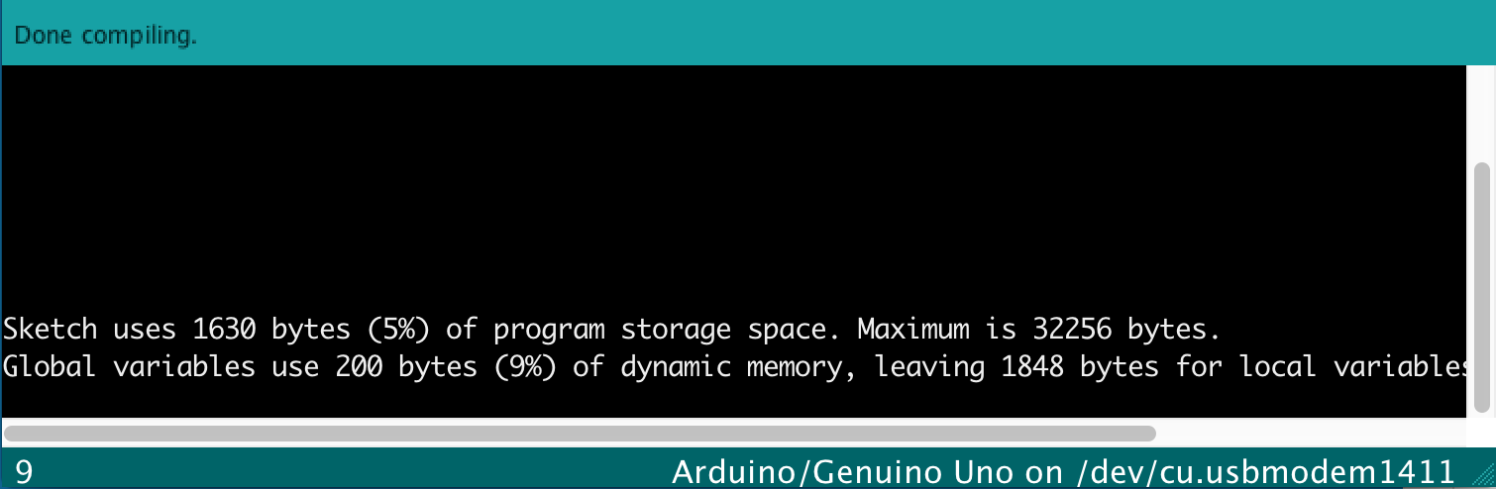
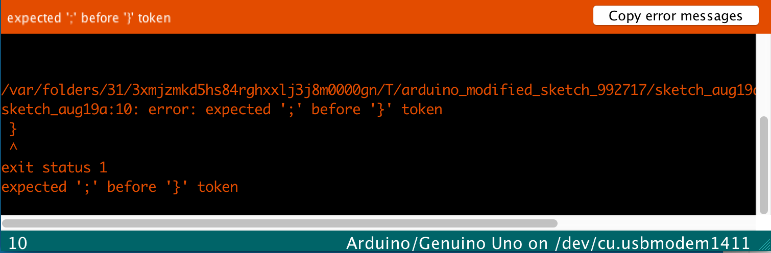
The Message Window

Slide 7
What are Functions ?
Functions are actions !

Slide 8
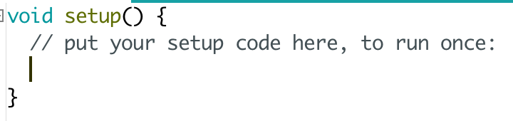
What does a Function look like ?
Name
Receive values
Return type
Start of function
Code
End of function

Slide 9
Making Toast
void makeToast () {
// Write steps to make toast
}
How many slices will this function make?
Will it be well done, medium or light ?

Slide 10
Making Toast II
void makeToast (numSlices, cookTimeInMinutes) {
// Write steps to make toast
}

Slide 11
Making Toast III
void makeToast (numSlices, cookTimeInMinutes) {
// Write steps to make toast
}
makeToast(2, 5)
makeToast(4, 10)
makeToast(10, 25)

Slide 12
Write your own Function
Here are some examples !
brushTeeth()
goToBed()
makeCoffee()
getReadyForSchool()
eatDinner()

Slide 13
Variables, Constants & Assignments
= 5
= 4
= 6

Slide 14
Variables, Constants & Assignments
+

Slide 15
Variables in Code
banana = 4;
orange = 5;
apple = 6;
orange + apple = ?

Slide 16
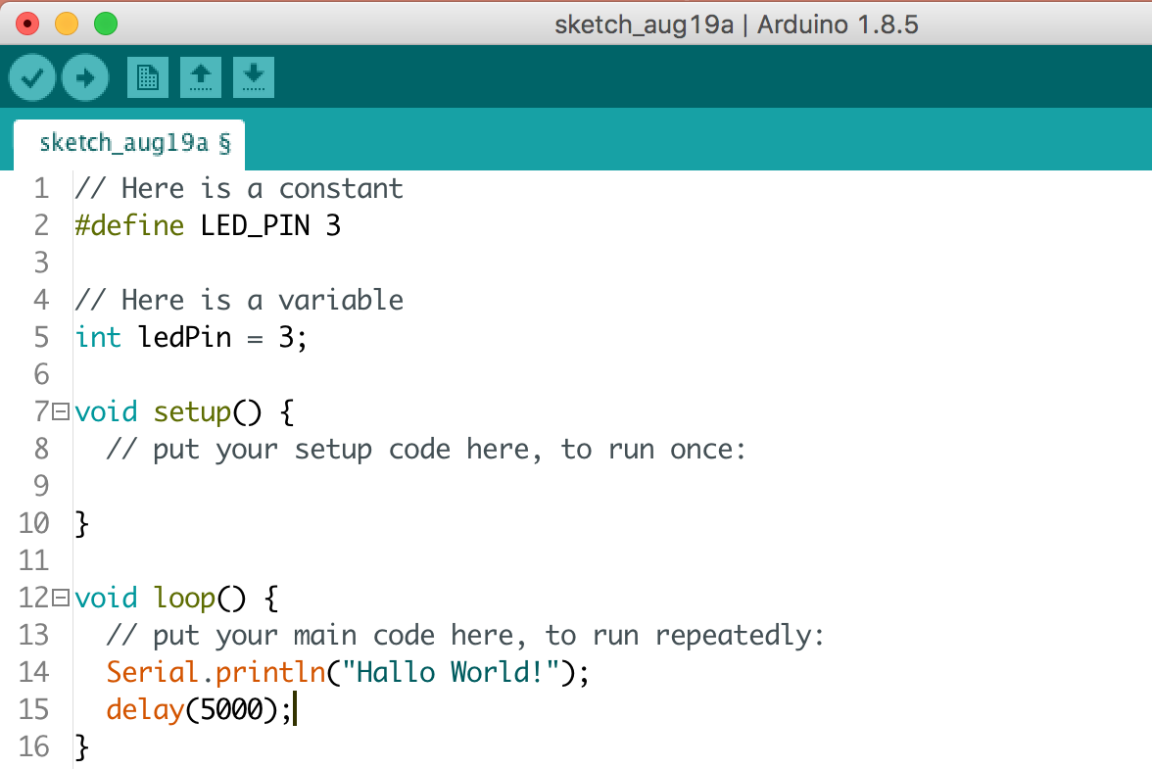
Creating Constants/Variables in Arduino
Constants once set, can’t change
Variables, however can change

Slide 17
Delays/Waiting
delay(1000);
delay(500);
What are we telling the delay function to do here?
delay is a function

Slide 18
Comments
// This is a single line comment
/* This is a
multiline comment
*/
Comments are NOT code
They just explain what the code is doing.
You should use them !!

Slide 19
Homework
Try and write your own version of the Blink Sketch.
In the handouts directory there is a file called homework-challenge.txt to help
https://www.github.com/nexgencodecamp/ytp/modules/arduino/04-coding-deeperdive/handouts

Slide 20


